Slide 1
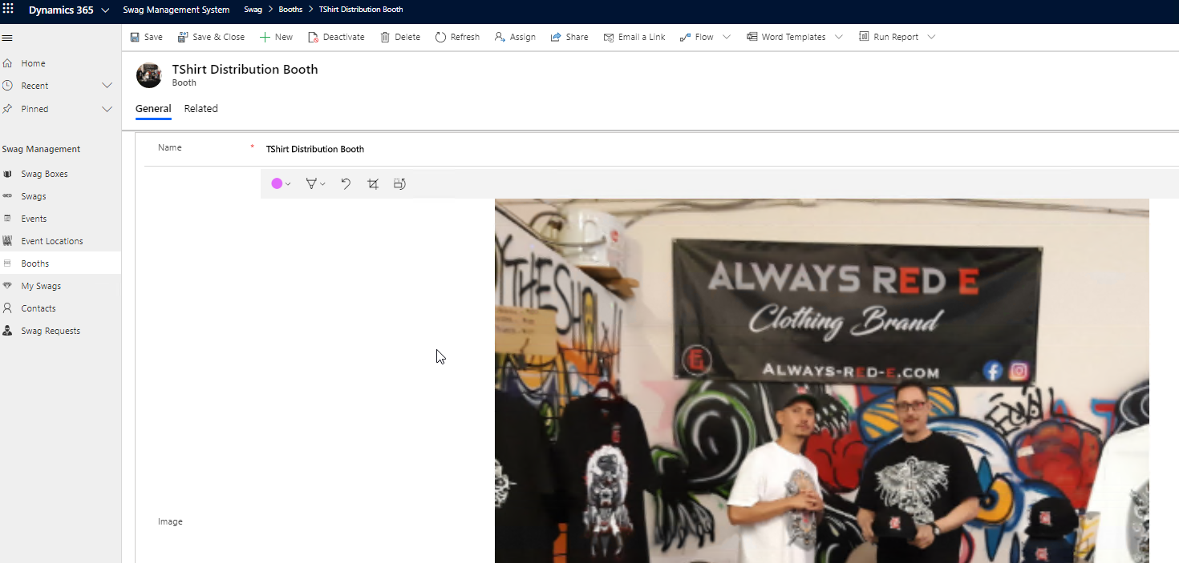
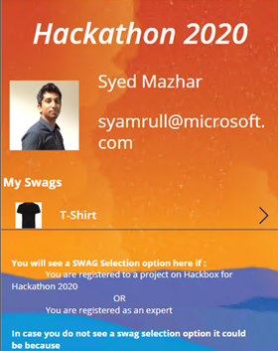
Swag management System
Plan, Design, Package and Distribute Swags

Slide 2
OneSwag

Slide 3
Technologies Leveraged
Power Platform
1
Model Driven application
2
Canvas App
3
Power Automate
4

Slide 4
Features Supported
Plan Swag Distribution in Mega or Virtual Events
Booth Management
Plan, Prepare, Design Swag Boxes
Swag Management
Swag Tracking
End User Visibility on Swag

Slide 5
Ready to Use Application
Swag Management System – Model Driven Application developed with no code approach.
Swag Tracker – Canvas Application developed for end users to see swags assigned and provide additional information for swag processing

Slide 6
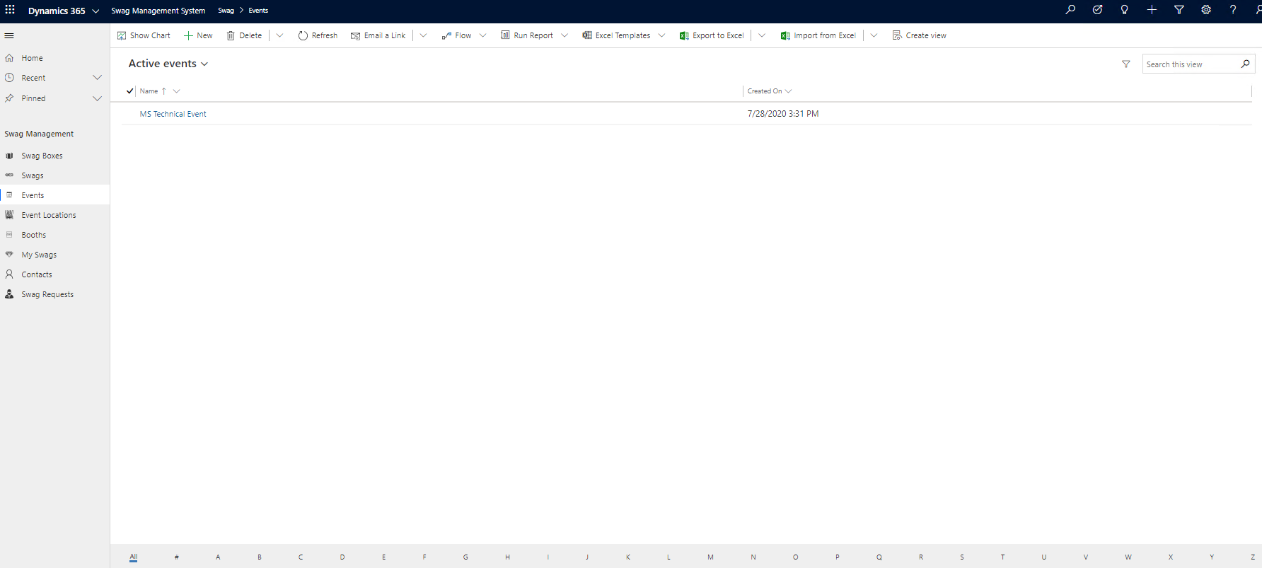
Glimpse of Swag Management System

Slide 7
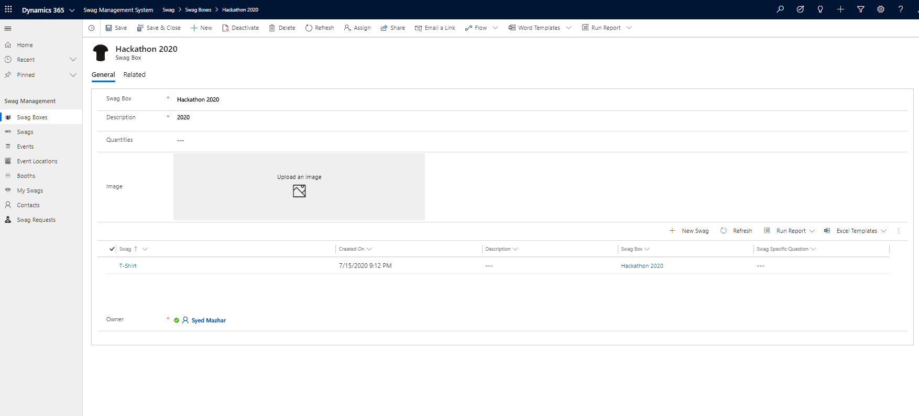
Create Swag Boxes – Collection of Goodies

Slide 8
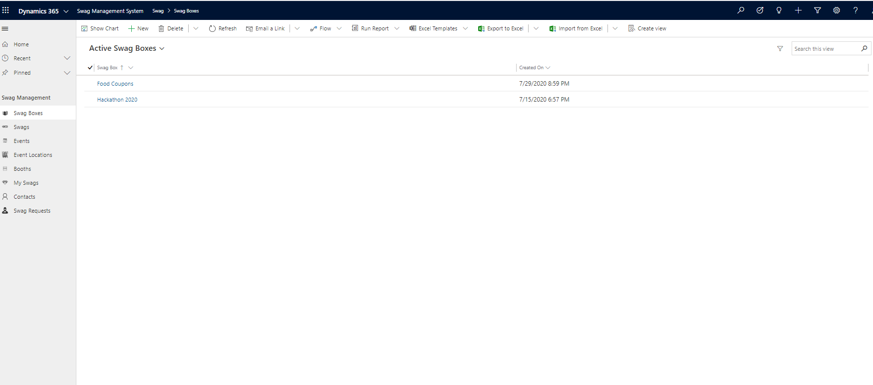
View Swag Boxes

Slide 9
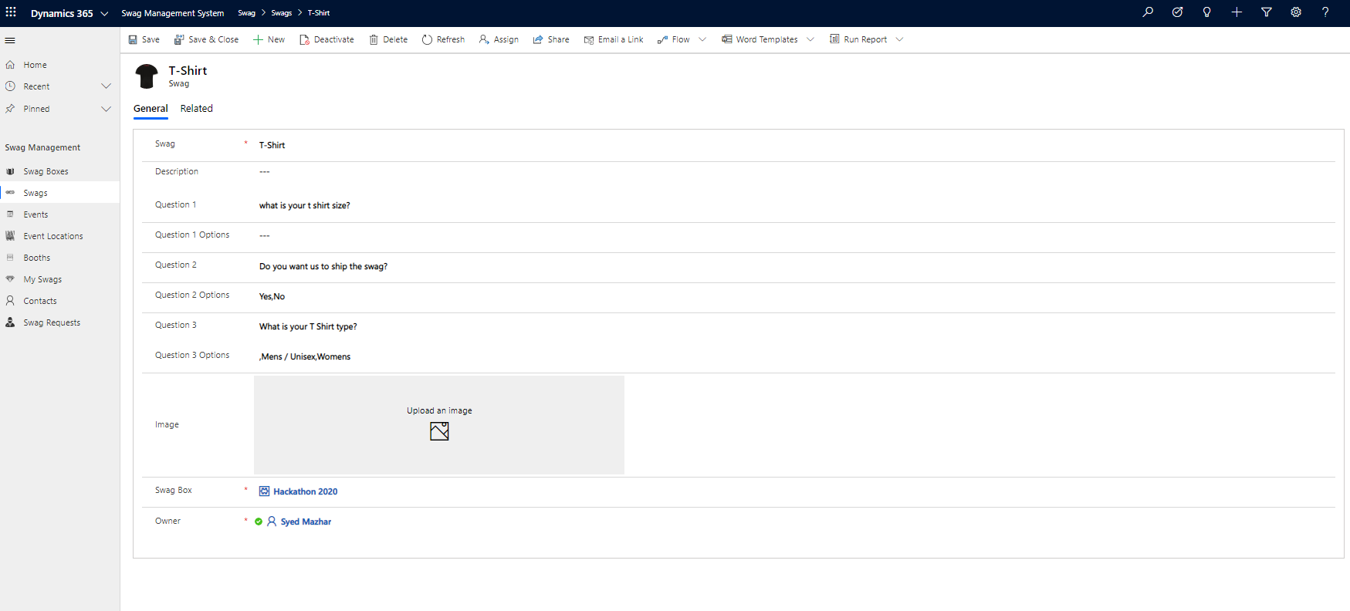
Fill Swag Box with Swags / Goodies

Slide 10
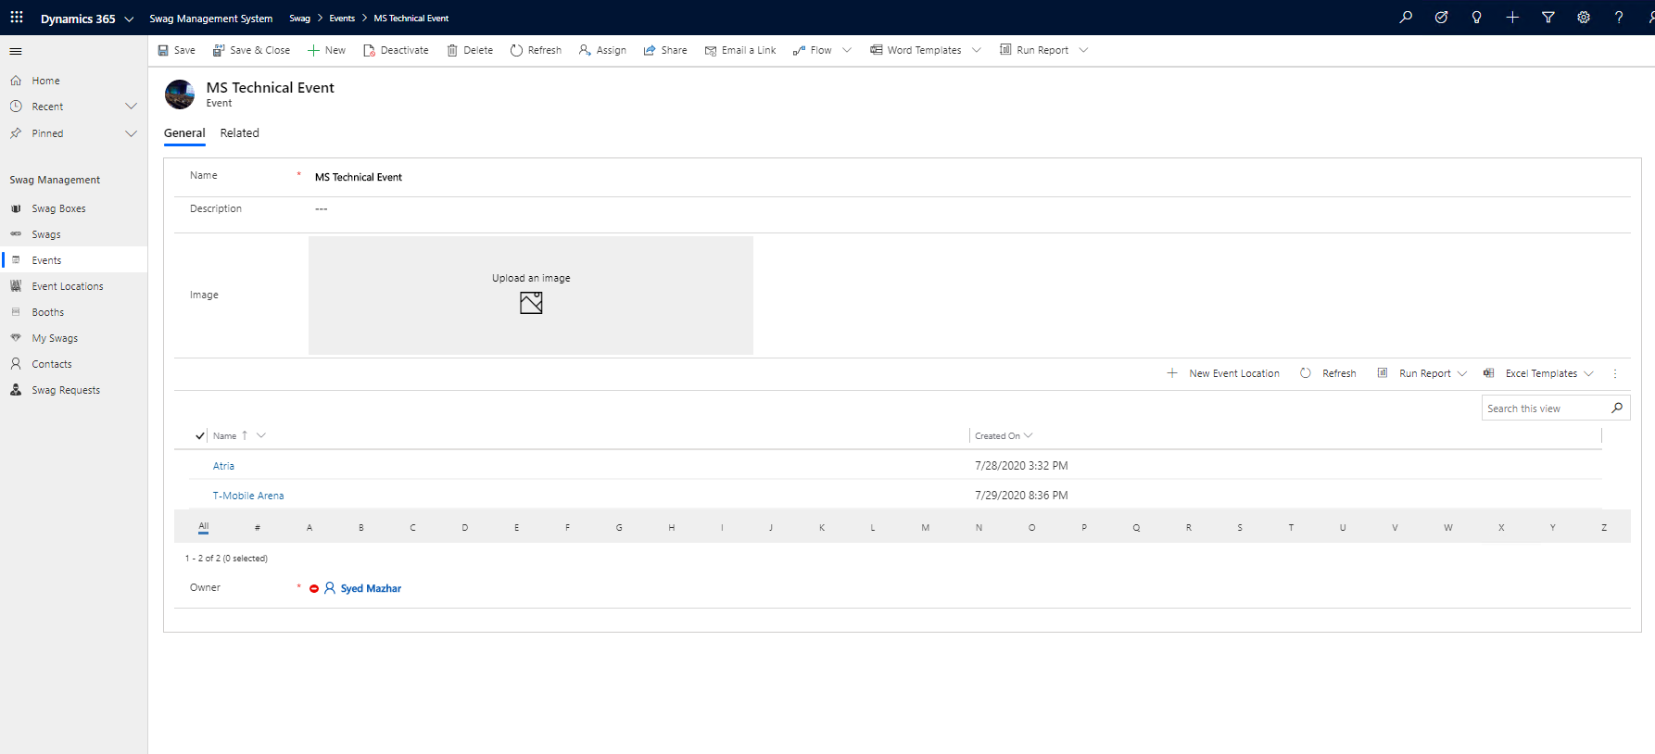
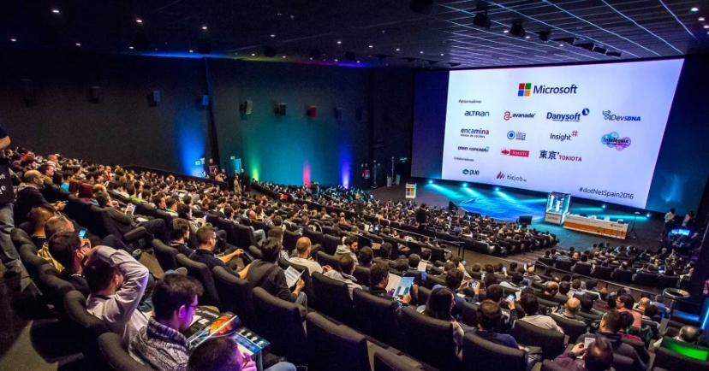
Configure mega events for Swag Distribution

Slide 11
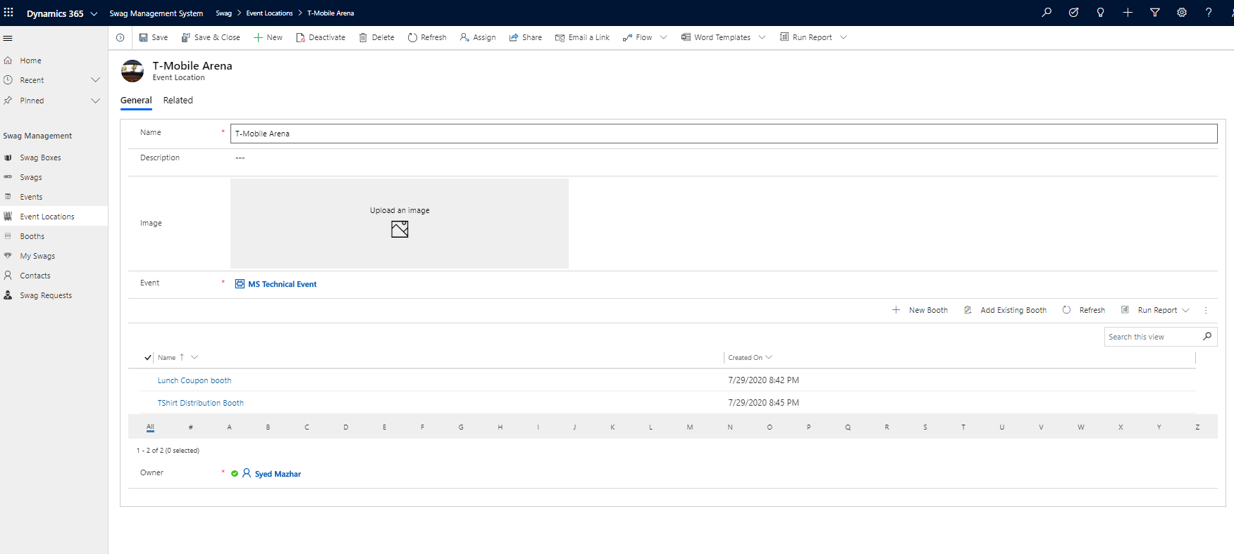
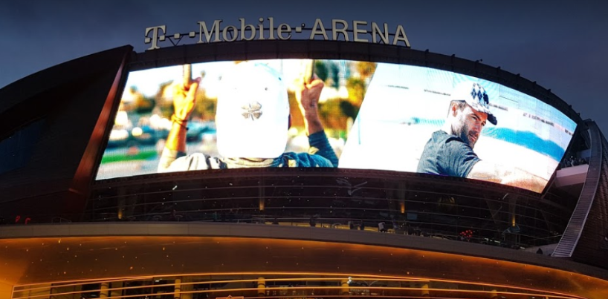
Configure event locations for Swag Distribution

Slide 12
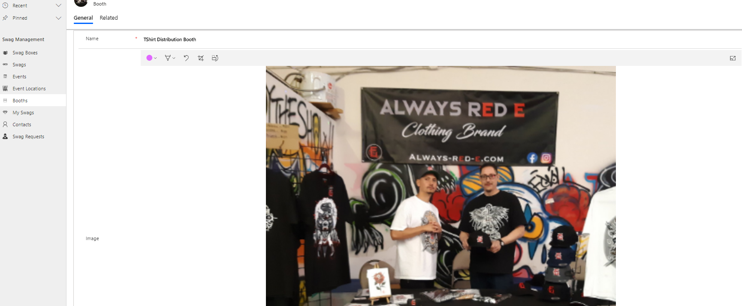
Setup Booths Event Location

Slide 13
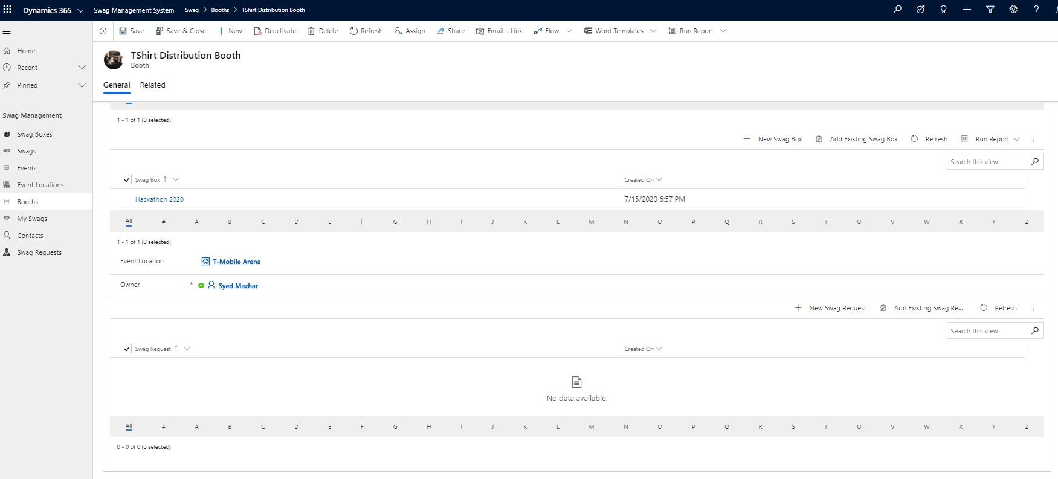
Setup Booth Owners and Swag Boxes

Slide 14
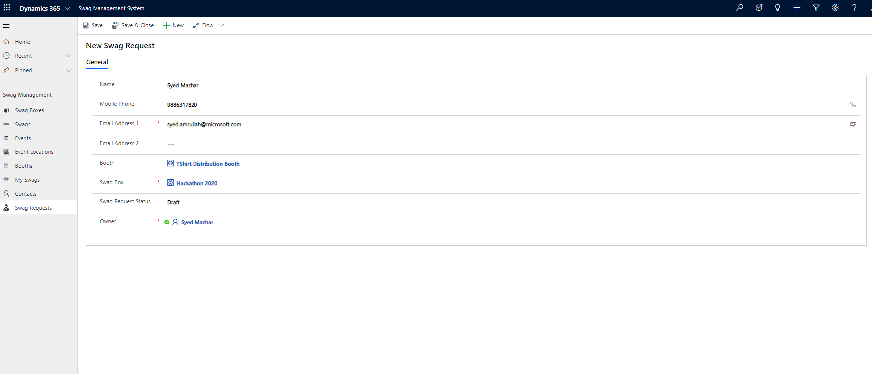
Distribute Swag From Booth

Slide 15
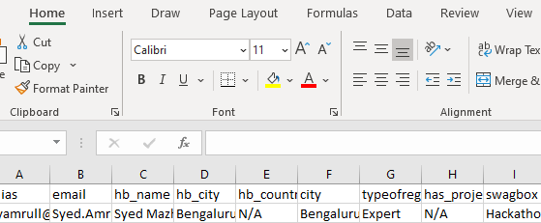
Distribute Swags using Power of Excel

Slide 16
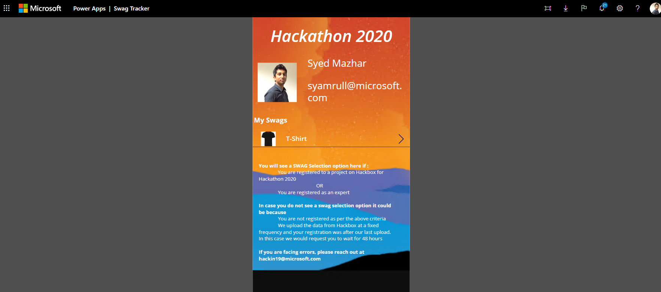
Swag Tracker – End user visibility on Swags assigned to him

Slide 17
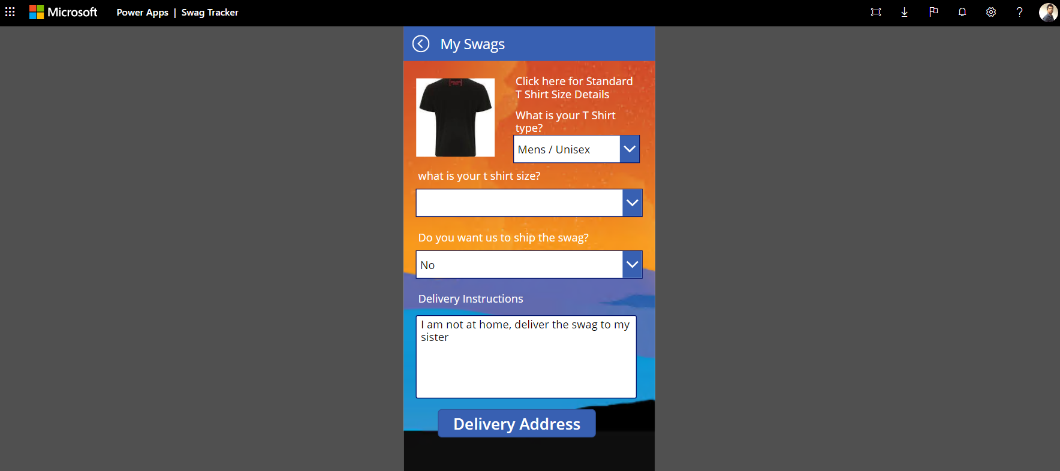
Swag Tracker – End user can update delivery information

Slide 18
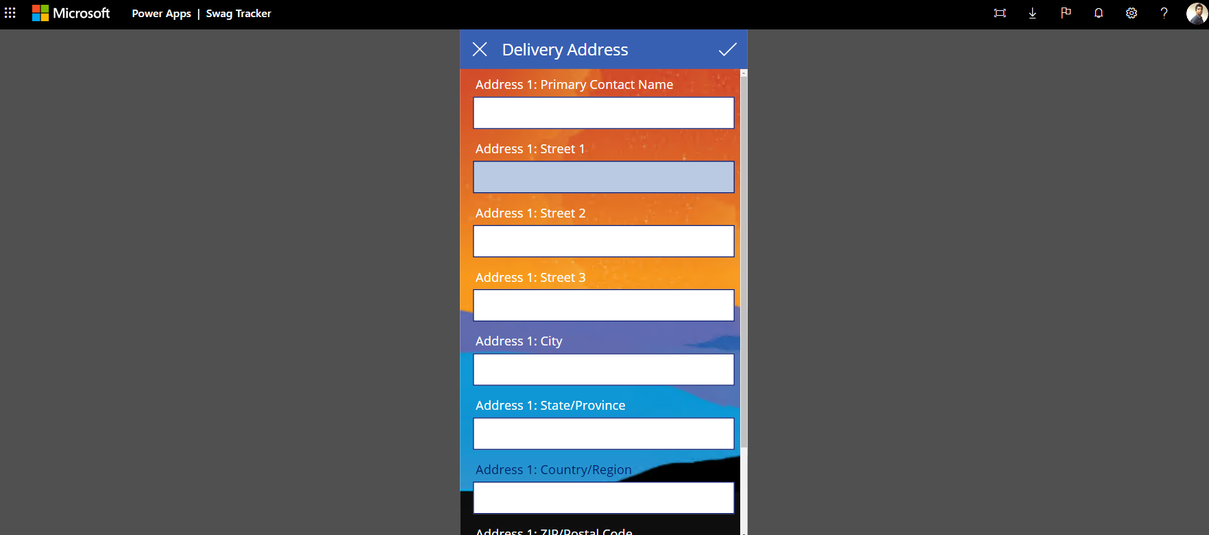
Swag Tracker

Slide 19
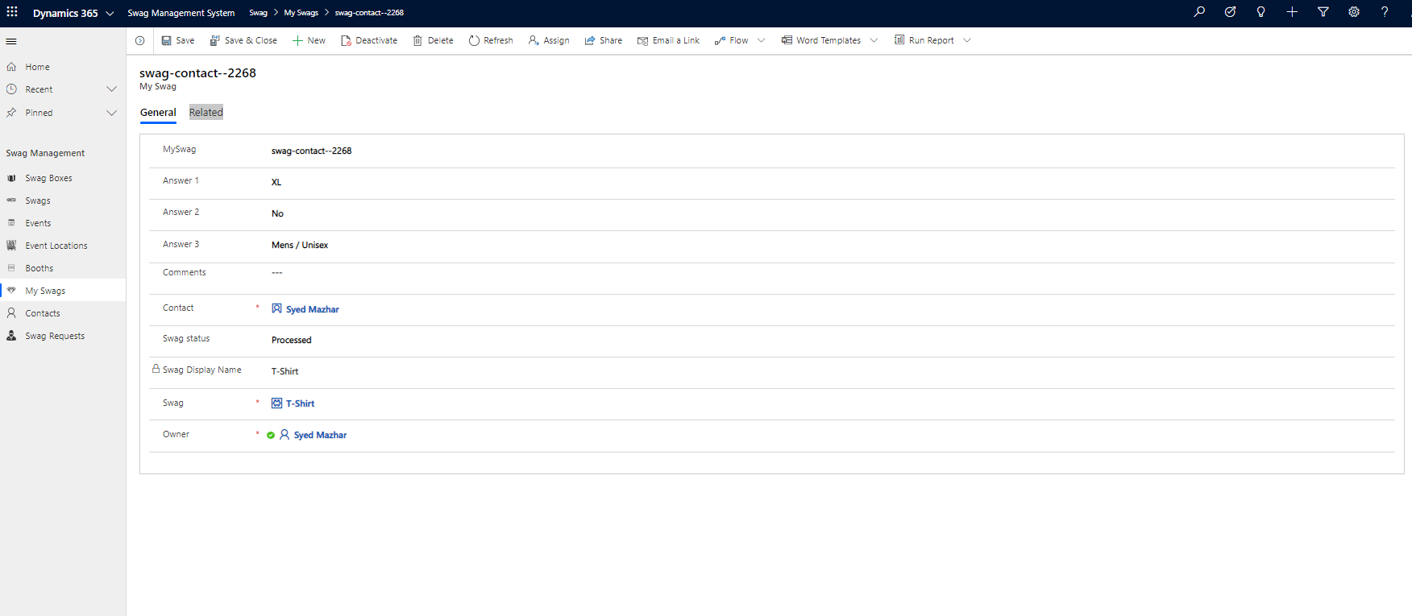
Swag status – View status of Swags

